Slide 1

Institutional Effectiveness Plan
University Advancement

Slide 2


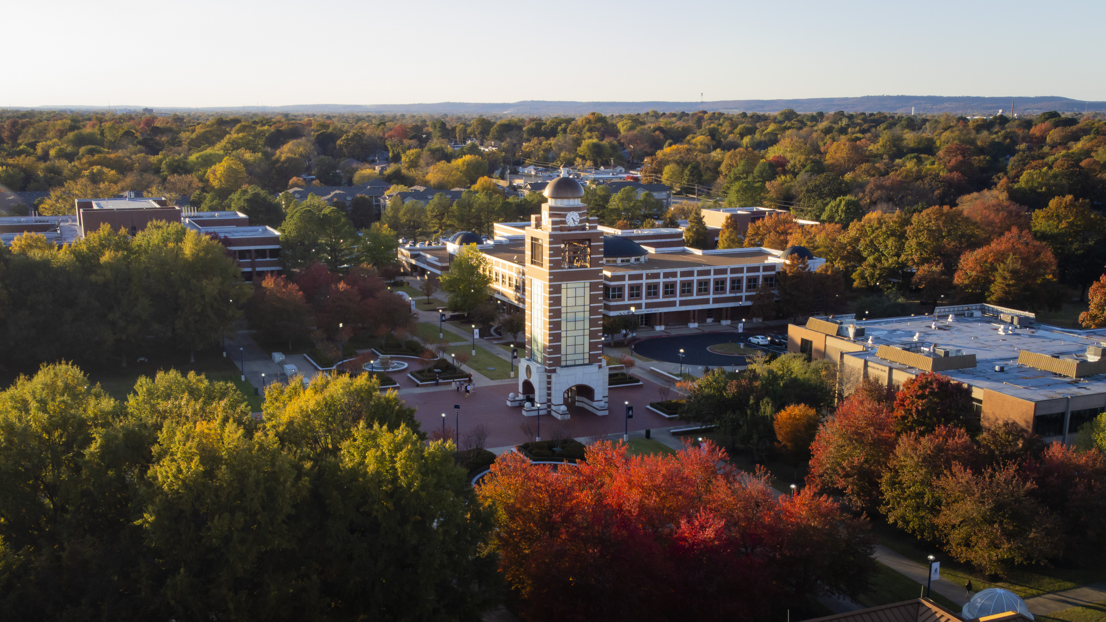
Advancement
Making forward progress related to a university's strategic plan
Alumni Engagement
Communications
Development
Foundation Finance & Operations
Marketing
The UAFS Foundation Inc.
Notes:
UAFS’s strategic plan is empowering, visionary, and adaptable but most importantly it is actionable.

Slide 3


2024-2025 Highlights
The Campaign
  Launched Public Phase on April 2, 2025 and Finished FY25 Ahead of Schedule
Alumni Engagement
  Surpassed Day of Giving Goals and Began Implementation of New Strategies
Development
  Key Commitments for Centers of Excellence and Successful Public Phase Strategies
Communications
  Record Engagement Across Owned and Earned Media and Print Strategies
Marketing
  Records in Web/ChatBot Traffic, Licensing/Royalties, and Community Initiatives
  The UAFS Foundation Inc.
  Set a New High-Water Mark for Total Assets

Slide 4
Drive interest in UAFS as a first-choice institution and invest in innovative recruiting practices to ensure continued enrollment growth.
Strategic Plan 1.1
Drive interest in UAFS as a first-choice institution and invest in innovative recruiting practices to ensure continued enrollment growth.
FY 25 Objective
  Continue to adjust and evolve recruitment marketing tactics, emphasizing proven and effective strategies.
Results
  Website (FY25)
    Sessions- 1,016,286
    RFI Ratio- TBD
    Avg. Search Position- 22.8
    ChatBot Sessions- 10,506

Slide 5
Drive interest in UAFS as a first-choice institution and invest in innovative recruiting practices to ensure continued enrollment growth.
Strategic Plan 1.1
Drive interest in UAFS as a first-choice institution and invest in innovative recruiting practices to ensure continued enrollment growth.
FY 26 Objective
  Continue the evolution of the recruitment marketing strategies. Aside from the current tactics, additional emphasis will be placed on RFI Forms, Slate Events, and ChatBot data. This information will lead to a better understanding of conversion tactics. Furthermore, landing page optimization will continue with a goal to affect Average Search Position.
  Goals
  Website (FY25)
    Sessions- 1,000,000
    Slate Events- 250,000
    RFI Forms- 20,000
    ChatBot Sessions- 12,000
      Baselines to be set
          Messages Sent
          “Thumbs Up” Rating
          Hours of Time Saved
          Avg. Response Time
          Conversations
          Top Topics

Slide 6
Optimize comprehensive institutional and private aid practices to ensure a UAFS education is accessible to all.
Strategic Plan 1.4
Optimize comprehensive institutional and private aid practices to ensure a UAFS education is accessible to all.
FY 25 Objective
  Optimize the deployment of UAFS Foundation student aid mechanisms.
Results
  Scholarships
    Available- $4,076,513
    Awarded- $3,146,742
    Percent- 77%
  Students Awarded- 1,937
    Average Amount- $1,625
  New Scholarships- 4
    Amount- $608,929

Slide 7
Optimize comprehensive institutional and private aid practices to ensure a UAFS education is accessible to all.
Strategic Plan 1.4
Optimize comprehensive institutional and private aid practices to ensure a UAFS education is accessible to all.
FY 26 Objective
  Increase the volume of UAFS Foundation aid and align with strategies to maximize comprehensive aid leveraging.
Goals
  Scholarships
    Available- $4,000,000
    Awarded- $3,200,000
    Percent- 80%
  Students Awarded- 2,000
    Average Amount- $1,600
  New Scholarships- 10
    Amount- $250,000

Slide 8
  Expand local brand strategies, grow the licensing and royalties program, and evolve strategies to tell the UAFS story.
Strategic Plan 1.6
Continue to invest in and promote the UAFS brand while developing new ways to tell the UAFS story across constituent groups.
FY 25 Objective
  Expand local brand strategies, grow the licensing and royalties program, and evolve strategies to tell the UAFS story.
Results
  Community Strategies
    Paint the Town Blue- 99
    Perk Stop- 15
    Alum Owned Business- 47
  Licensing Management
    Royalties- $11,582
    Gross Sales- $95,316
    Total Units- 7,074
    Licensed Vendors- 61
    Retail Locations- 8
  Strategic Communications
    Social Media
      13.1M Impressions
      50,911 Engagements
      235 Accounts
  Newsroom
    200 Releases Distributed
    75,515 Page Views
    1:09/page
  Newsletters
    65 Newsletters
  Print Publications
    Belltower- 18,000
    Chancellor’s Report- 3,000
    Foundation Report- 400
  Earned Media Coverage
    3,015 Mentions
    389 News Sources
    601.8k Impressions
    0.75% Neg Sentiment

Slide 9
  Continue the expansion of local brand strategies, grow the licensing and royalties' program with an emphasis on new retail locations and expansion of the Walmart partnership, and expand the already successful strategy of telling the UAFS story.
Strategic Plan 1.6
Continue to invest in and promote the UAFS brand while developing new ways to tell the UAFS story across constituent groups.
FY 26 Objective
  Continue the expansion of local brand strategies, grow the licensing and royalties program with an emphasis on new retail locations and expansion of the Walmart partnership, and expand the already successful strategy of telling the UAFS story.
Goals
  Community Strategies
    Paint the Town Blue- 105
    Perk Stop- 17
    Alum Owned Business- 50
  Licensing Management
    Royalties- $15,000
    Gross Sales- $100,000
    Total Units- 7,500
    Licensed Vendors- 65
    Retail Locations- 10
  Strategic Communications
    Social Media
      13M Impressions
      60,000 Engagements
      200 Accounts
  Newsroom
    200 Releases Distributed
    70,000 Page Views
    1:00/page
  Newsletters
    65 Newsletters
  Print Publications
    Belltower- 18,000
    Chancellor’s Report- 3,000
    Foundation Report- 400
  Earned Media Coverage
    3,000 Mentions
    350 News Sources
    1M Impressions
    1% Neg Sentiment

Slide 10
  Utilize comprehensive advancement strategies to support the Centers of Excellence.
Strategic Plan 2.3.4
Establish centers of excellence to enhance academic programs in high-demand fields, support student success, and power the regional economy.
FY 25 Objective
  Utilize comprehensive advancement strategies to support the Centers of Excellence.
Results
  $7.625M to Establish the Center for Nonprofits (Economic Development)
  $60k for Nursing and Engineering Scholarships (Health Sciences & Advanced Manufacturing)
  $35K to Art Scholarships (Art & Design)
  $25k to Nursing Scholarships (Health Sciences)
  Specialized Workforce Marketing Campaign to Boost CTE in the Region (Economic Development)
  Facilitated Data Science Listening Tours (Data Science)
  All 5 Centers Represented in the Chancellor’s Report and 4 in Belltower

Slide 11
  Expand on the advancement support of the Centers of Excellence and intentionally grow each center related to the capabilities within advancement.
Strategic Plan 2.3.4
Establish centers of excellence to enhance academic programs in high-demand fields, support student success, and power the regional economy.
FY 26 Objective
  Expand on the advancement support of the Centers of Excellence and intentionally grow each center related to the capabilities within advancement.
Goals
  Begin capital project fundraising for a Center for Advanced Manufacturing (Advanced Manufacturing)
  Begin capital project fundraising for a Center for Health Innovation (Health Sciences)
  Continue Major Gift/Grant Fundraising in Support of the Center for Nonprofits (Economic Development)
  Begin Planning External Engagement Strategies for Windgate Expansion Grand Opening (Art & Design)
  Complete Facilitated Listening Tours for Computer and Data Science (Computer and Data Science )
  All 5 Centers represented in the Chancellor’s Report, Belltower, and NEW Foundation Annual Report

Slide 12
  Achieve year-over-year goals of the development operations with specific strategies leading up to the public launch of the comprehensive campaign.
Strategic Plan 4.1.2
Advance the strategic priorities of the institution through meaningful philanthropic partnerships with individuals, corporations, and foundations, and align these resources to support student success, and empower transformative investments.
FY 25 Objective
  Achieve year-over-year goals of the development operations with specific strategies leading up to the public launch of the comprehensive campaign.
Results
  Development
    Production- $15,637,944
    Receipts- $7,039,022
    Proposal- 59
    Visits- 157
    Contacts- 408
  Campaign Progress
    Amount-$72,650,757
    Percent to Goal-85%

Slide 13
  Build on the strong launch of the public phase of the comprehensive campaign and deploy the development strategies that have been built for this purpose.
Strategic Plan 4.1.2
Advance the strategic priorities of the institution through meaningful philanthropic partnerships with individuals, corporations, and foundations, and align these resources to support student success, and empower transformative investments.
FY 26 Objective
  Build on the strong launch of the public phase of the comprehensive campaign and deploy the development strategies that have been built for this purpose.
Goals
  Development
    Production- $10,000,000
    Receipts- $8,000,000
    Proposal- 150
    Visits- 500
    Contacts- 1,000
  Campaign Progress
    Amount-$80,000,000
    Percent to Goal-94%

Slide 14
  Expand the alumni engagement operation and grow corporate partnerships.
Strategic Plan 4.2.3
Cultivate and expand purposeful, long-term, and mutually beneficial community partnerships, foster philanthropic efforts, and contribute to the region’s social, economic, and environmental success.
FY 25 Objective
  Expand the alumni engagement operation and grow corporate partnerships.
Results
  Alumni Engagement
    Total- 34,203
    Non-Degree- 19,787
    Events- 13/7
    Registered- 1,319
    Attended- 939
    Email Capture Rate- 100%
    Participation- 0.48%
  Corporate Sponsorship
    Companies- 43
    Production- $123,459

Slide 15
  Continue deploying the new alumni engagement strategic plan tactics and continue evolving the corporate partnership strategies.
Strategic Plan 4.2.3
Cultivate and expand purposeful, long-term, and mutually beneficial community partnerships, foster philanthropic efforts, and contribute to the region’s social, economic, and environmental success.
FY 26 Objective
  Continue deploying the new alumni engagement strategic plan tactics and continue evolving the corporate partnership strategies.
Goals
  Alumni Engagement
    Total- 35,000
    Non-Degree- 20,000
    Events- 15/7
    Registered- 1,200
    Attended- 900
    Email Capture Rate- 100%
    Participation- 1%
  Corporate Sponsorship
    Companies- 40
    Production- $120,000

Slide 16
  Continue strategies to grow the overall portfolio of the UAFS Foundation.
Strategic Plan 4.2.7
Strengthen institutional scholarship offerings and foundation endowments to ensure accessible and affordable opportunities for all students and support the transformative impact of UAFS on their lives and careers.
FY 25 Objective
  Continue strategies to grow the overall portfolio of the UAFS Foundation.
Results
  UAFS Foundation
    6/30 Portfolio Balance- $155,468,673
    6/30 Endowment Balance- $113,919,085
  Endowed Funds
    Available- $3,755,050
    Awarded- $2,968,152
    Percent Spend- 79%
  Gift Revenue-FY26 Budget
    Total- $7,961,854

Slide 17
  Continue strategies to grow the overall portfolio of the UAFS Foundation and expand on opportunities for the campus to utilize and plan with Foundation funds.
Strategic Plan 4.2.7
Strengthen institutional scholarship offerings and foundation endowments to ensure accessible and affordable opportunities for all students and support the transformative impact of UAFS on their lives and careers.
FY 26 Objective
  Continue strategies to grow the overall portfolio of the UAFS Foundation and expand on opportunities for the campus to utilize and plan with Foundation funds.
Goals
  UAFS Foundation
    6/30 Portfolio Balance- $165,000,000
    6/30 Endowment Balance- $115,000,000
  Endowed Funds
    Available- $5,175,000
    Awarded- $4,140,000
    Percent Spend- 80%
  Gift Revenue-FY27 Budget
    Total- $9.5M

Slide 18
Short-term Resource Requests for FY27
Resource Description | Alignment with strategic plan pillar | Budget request on-going | Budget request one-time | Total of budget request for FY26
FY27 Budget Reductions from University Advancement Cost Centers | 4.2.4 | -$93,550 (Supplies/Services) -$108,500 (Salaries) |  | -$202,050
Institutional Salary Adjustments By Priority & When Available 1. Cost of Living Adjustment 2. Raise the UAFS salary floor to the higher of $15/hr. or 15th percentile of CUPA data, following up on previous efforts to reach the 10th percentile with a long-range goal of sustaining a floor of 25th percentile. 3. Merit pool to reward high performers | 2.2 | TBD | TBD | TBD

Slide 19
Long-term Resource Requests
Resource Description | Alignment with strategic plan pillar | Budget request on-going | Budget request one-time | Total of budget request for FY??
Institutional Salary Adjustments By Priority & When Available 1. Cost of Living Adjustment 2. Raise the UAFS salary floor to the higher of $15/hr. or 15th percentile of CUPA data, following up on previous efforts to reach the 10th percentile with a long-range goal of sustaining a floor of 25th percentile. 3. Merit pool to reward high performers | 2.2 | TBD | TBD | TBD
Targeted Efforts in Strategic Recruitment Marketing and Advertising | 1.1 | $250,000 |  | $250,000
Celebrate the Centennial and Conclusion of the Campaign | 1.6 | $300,000 (City-wide marketing push e.g. billboards, increase in mailing and print, and events) | $300,000

Slide 20
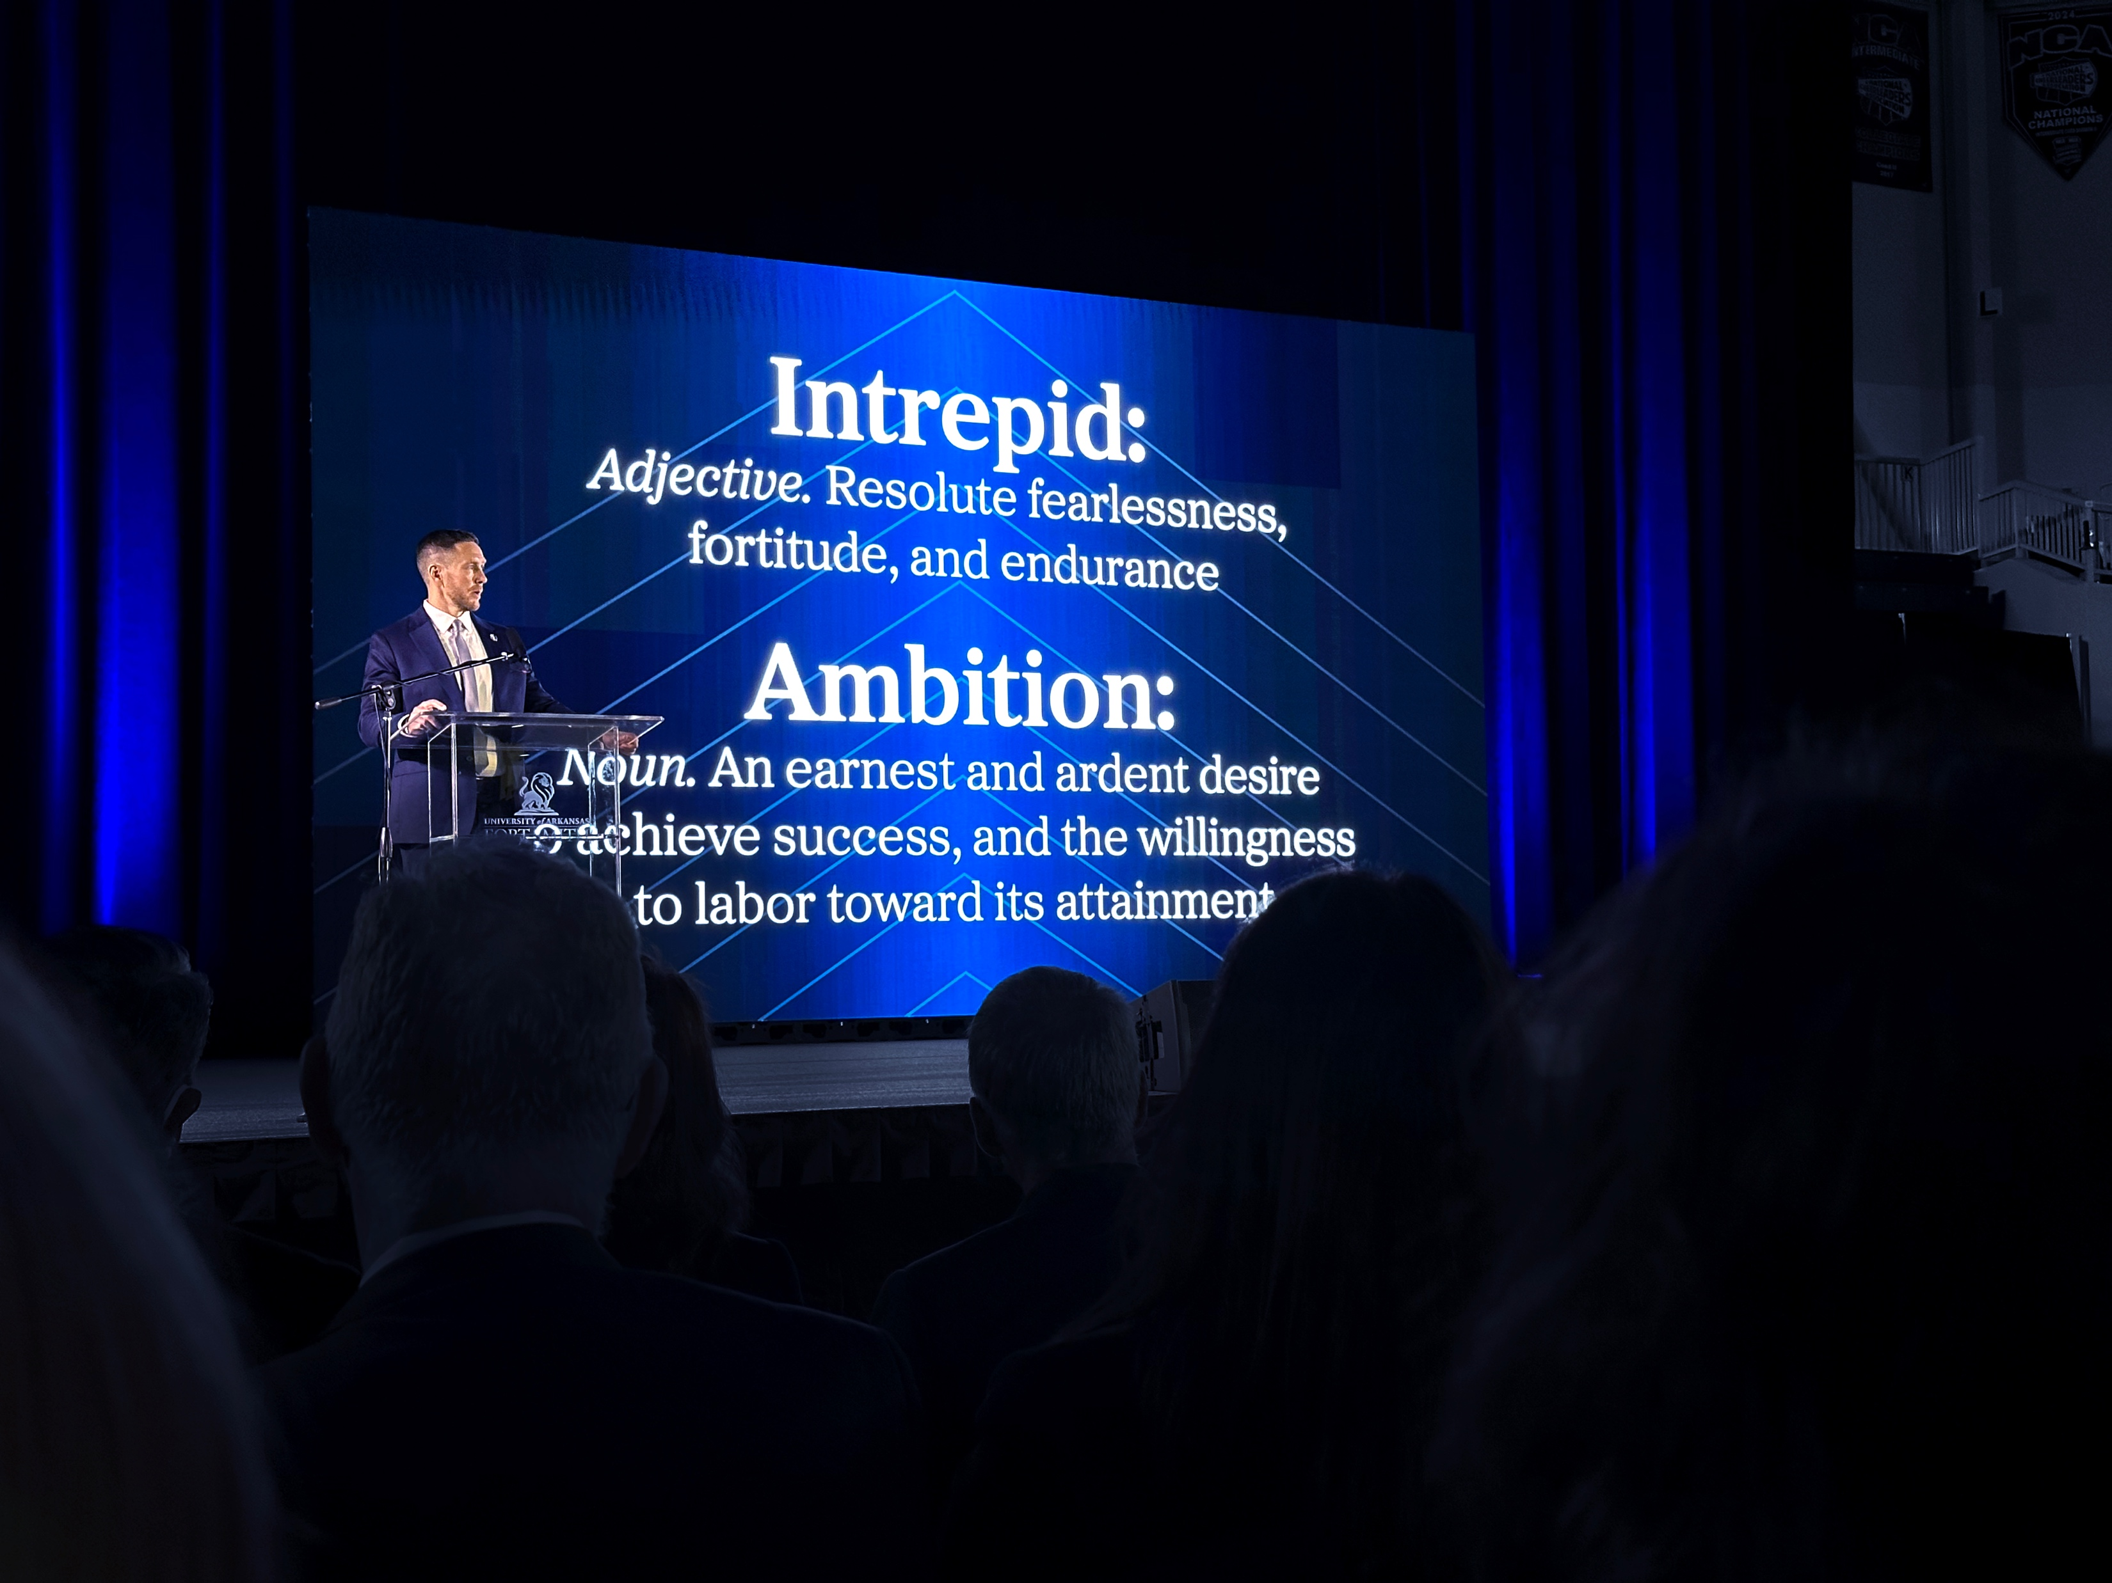

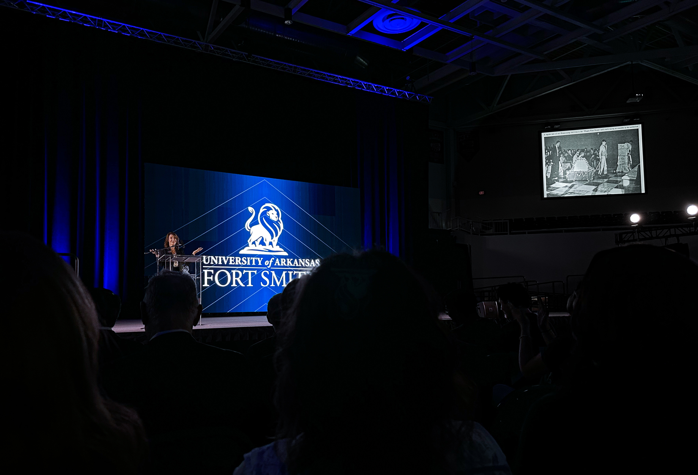
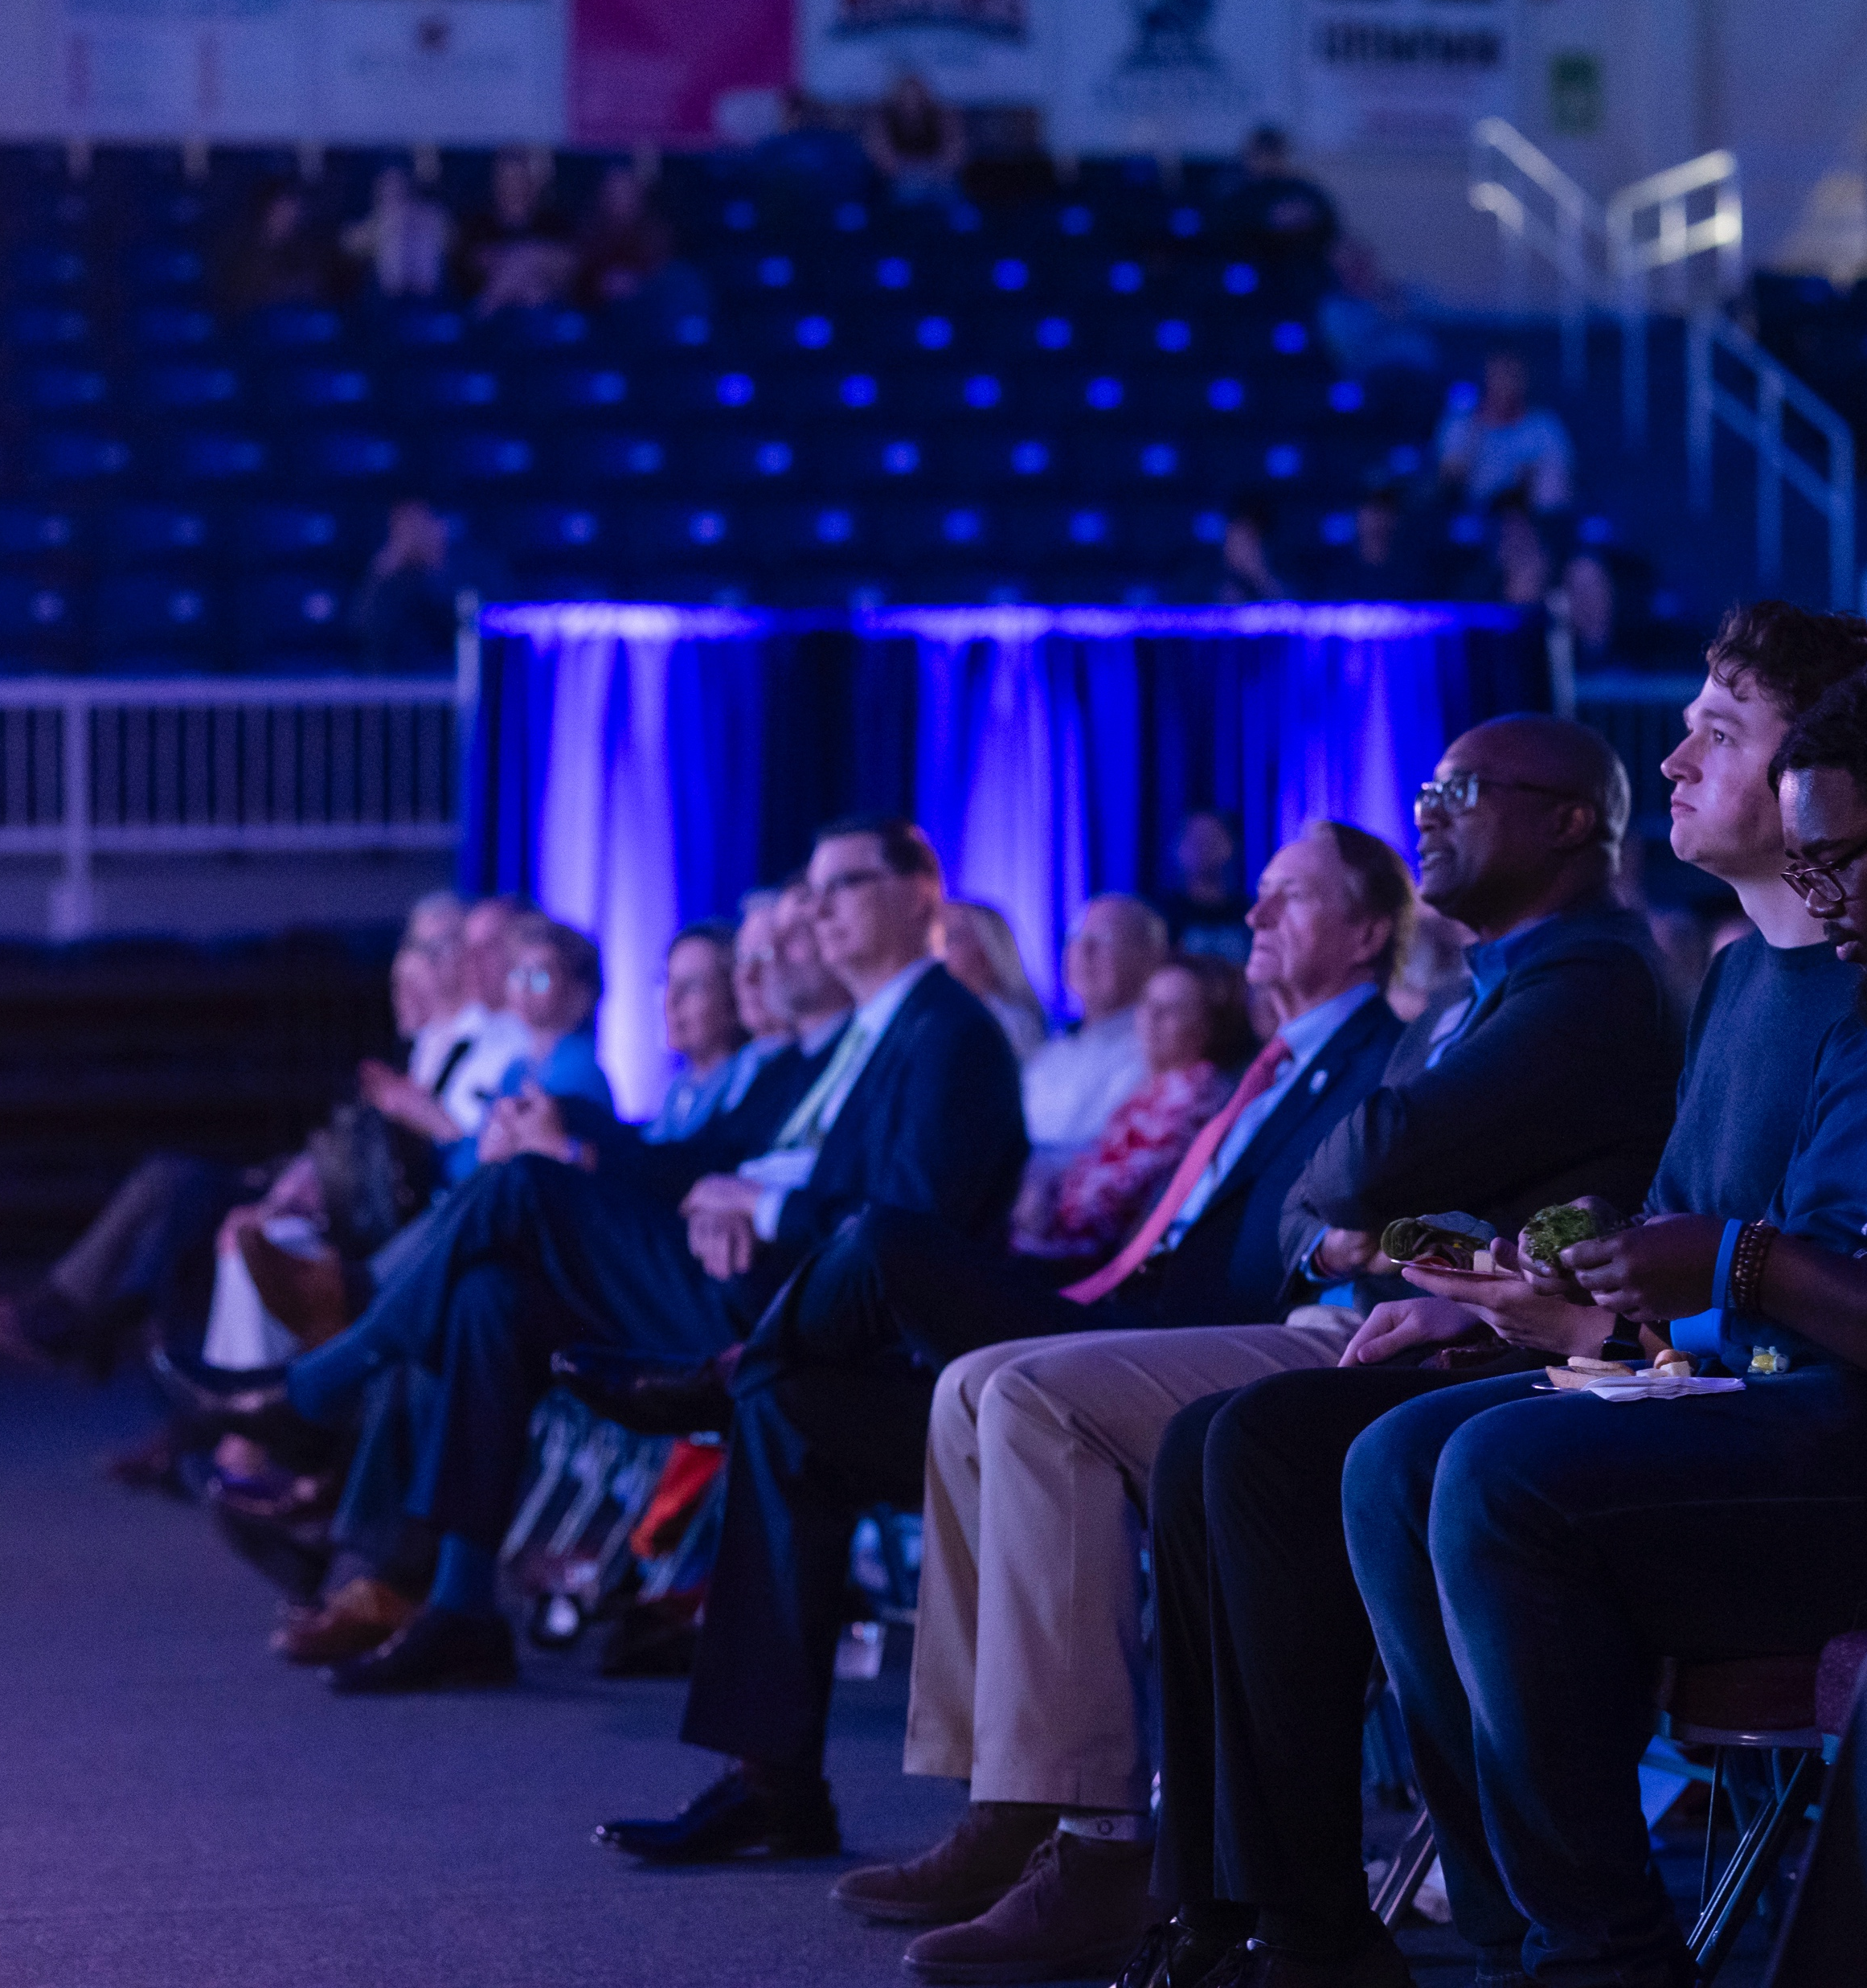
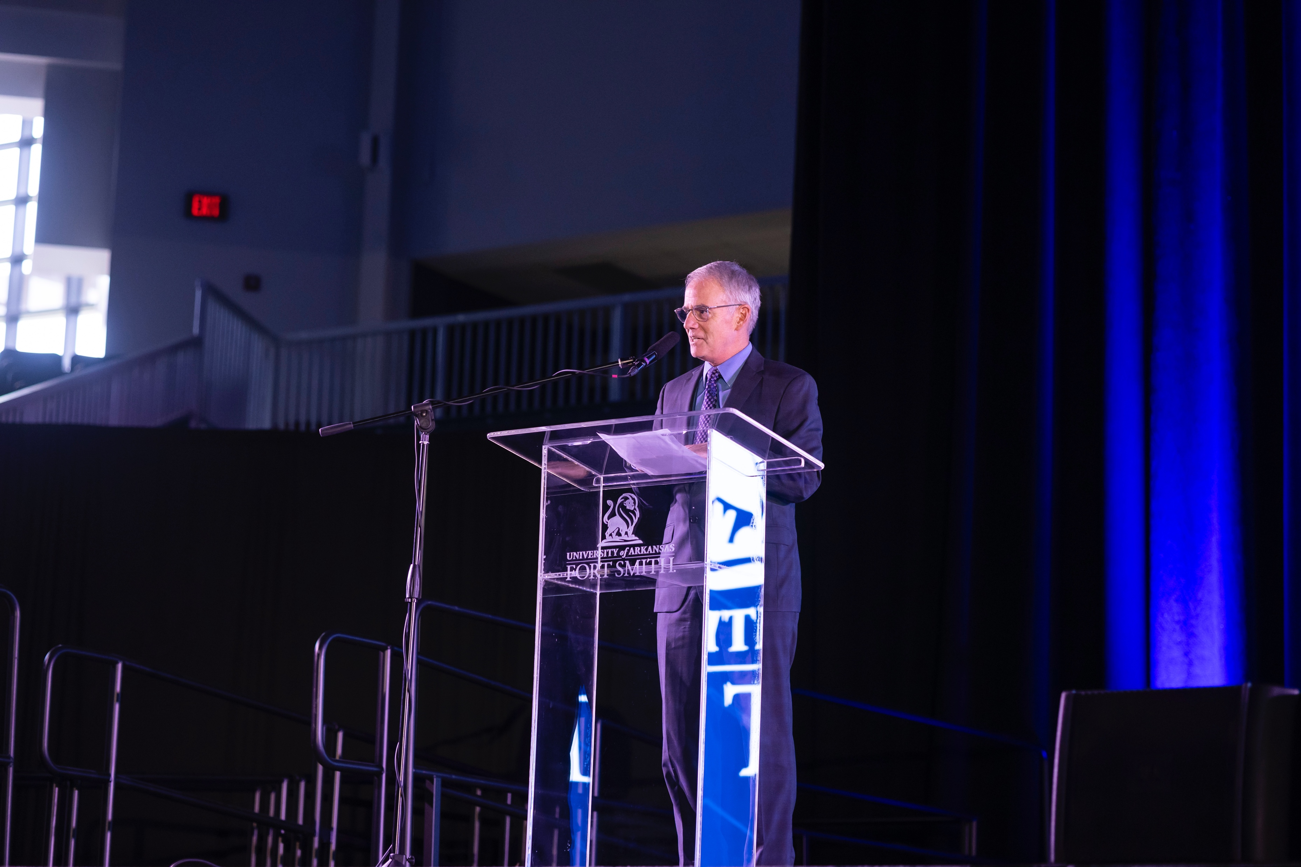
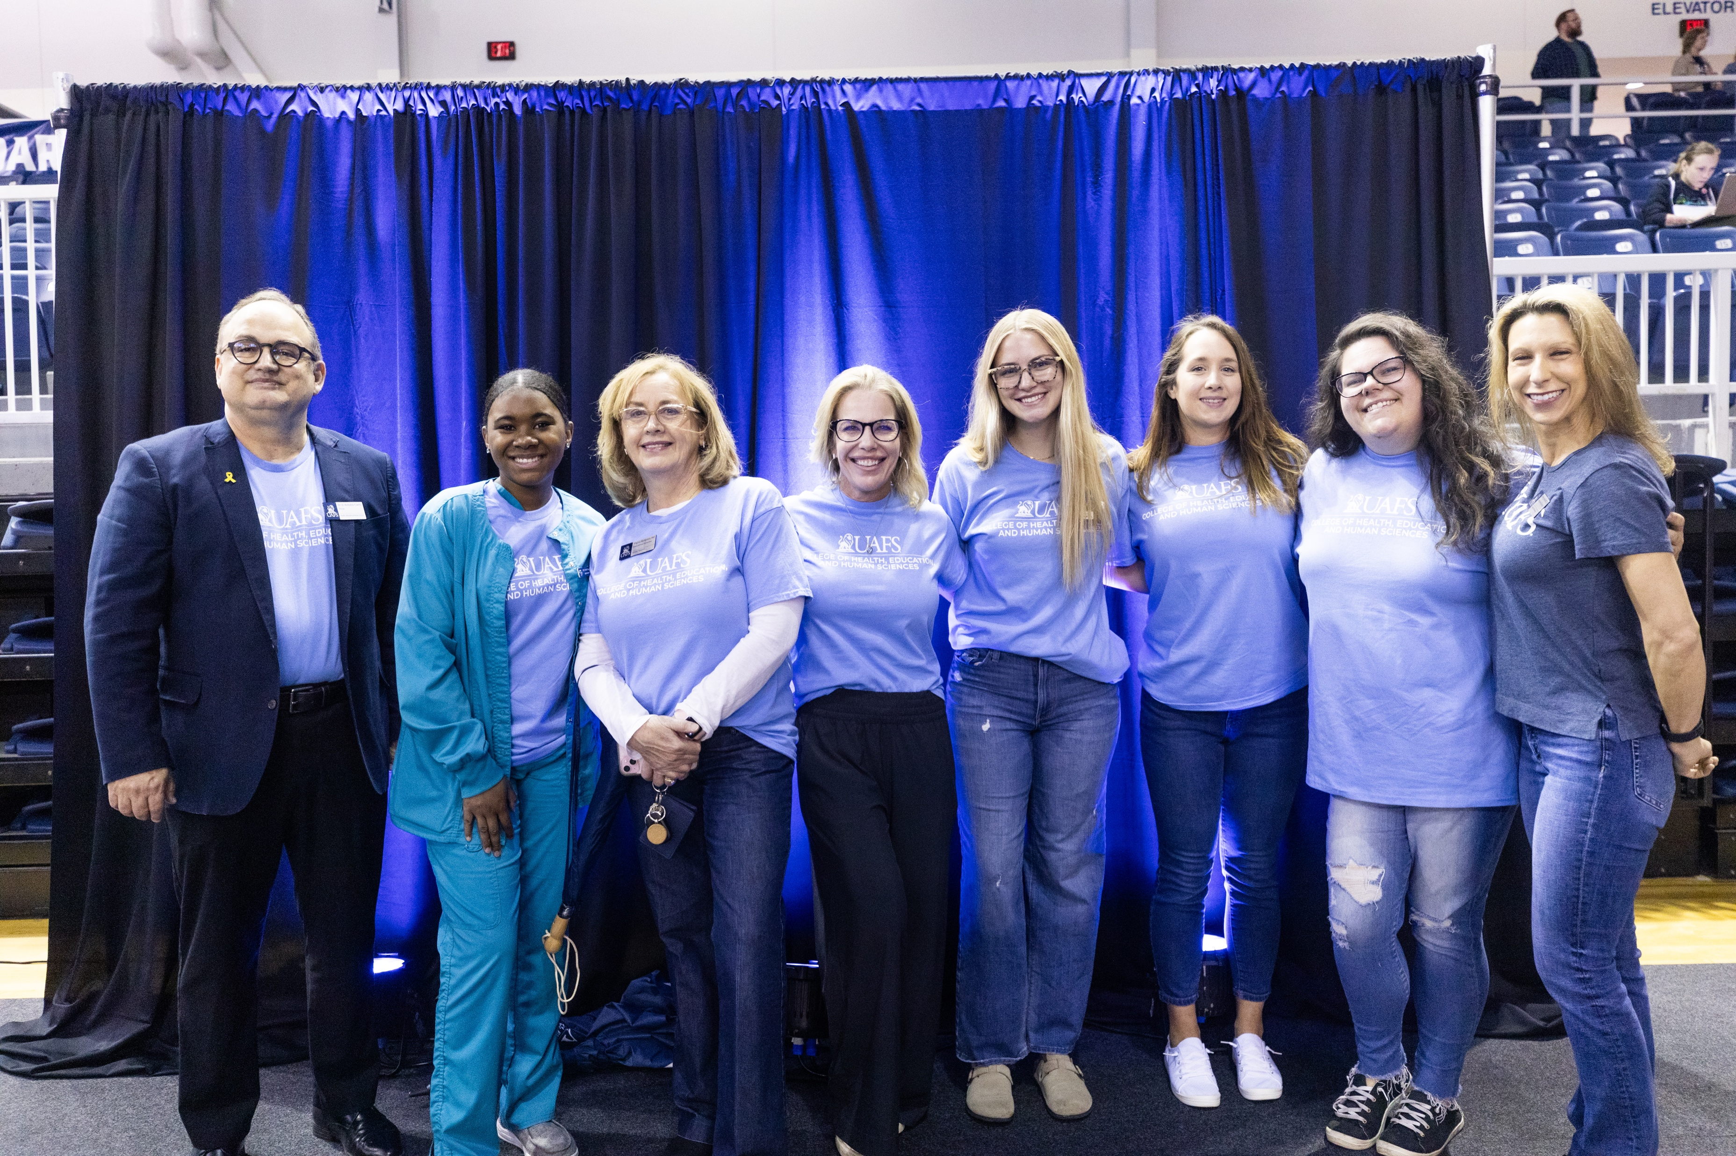
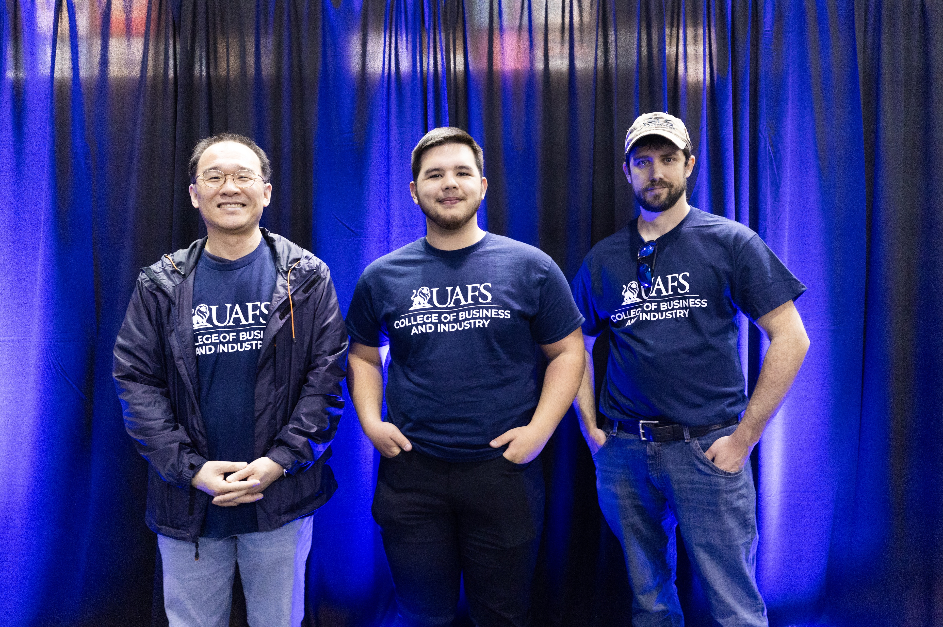
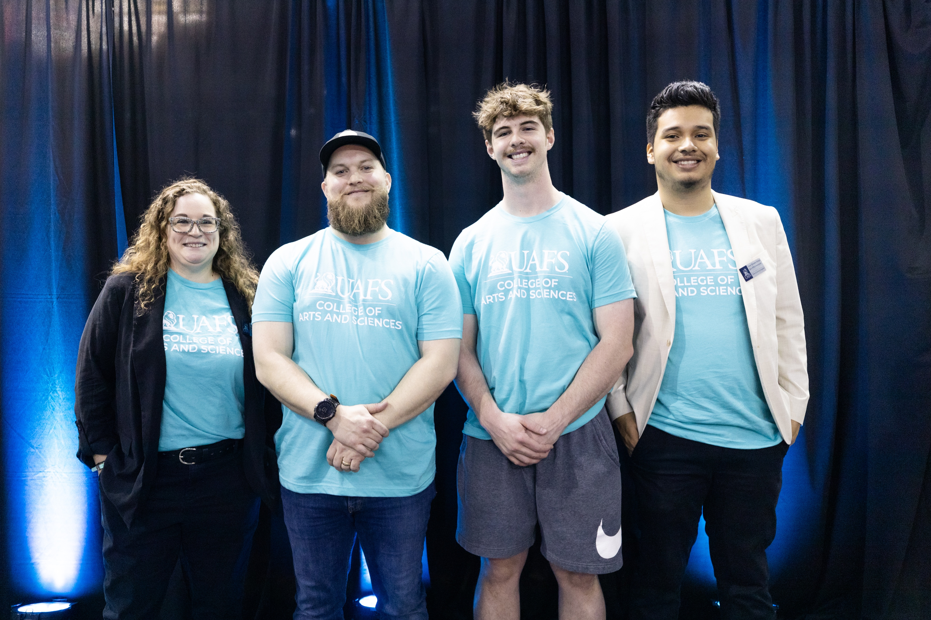
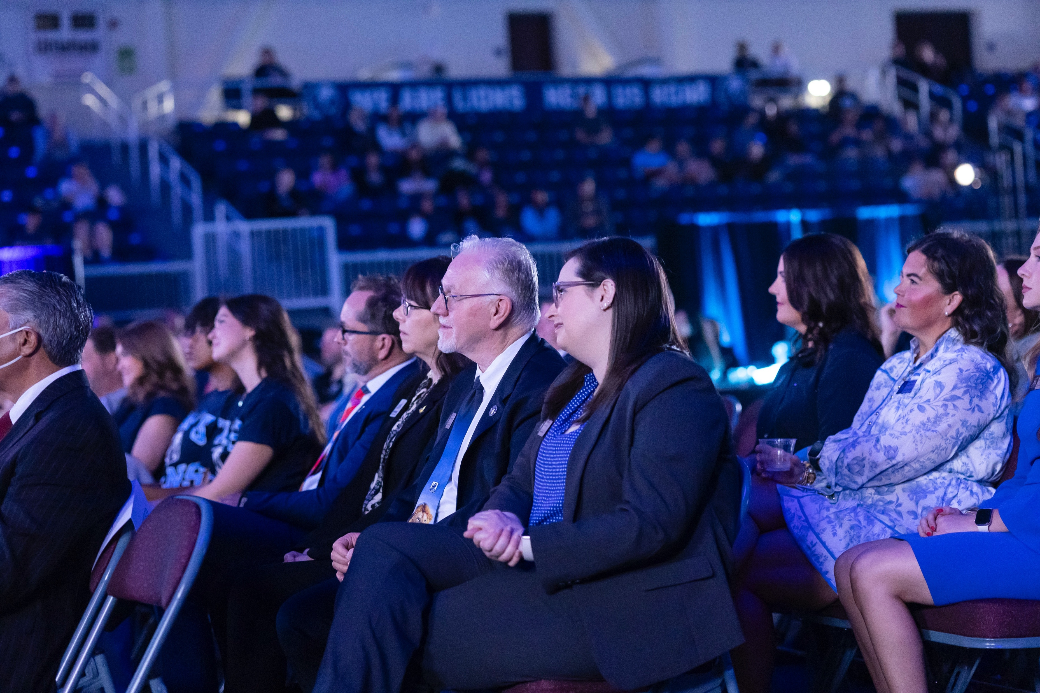
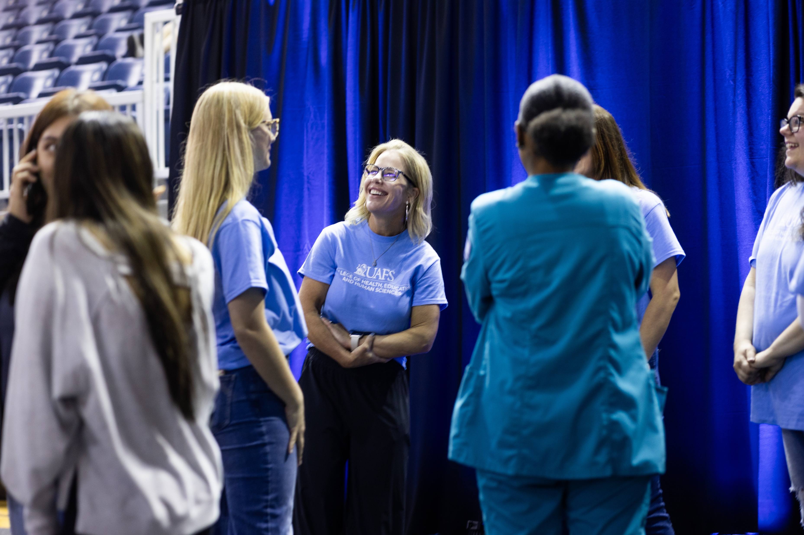
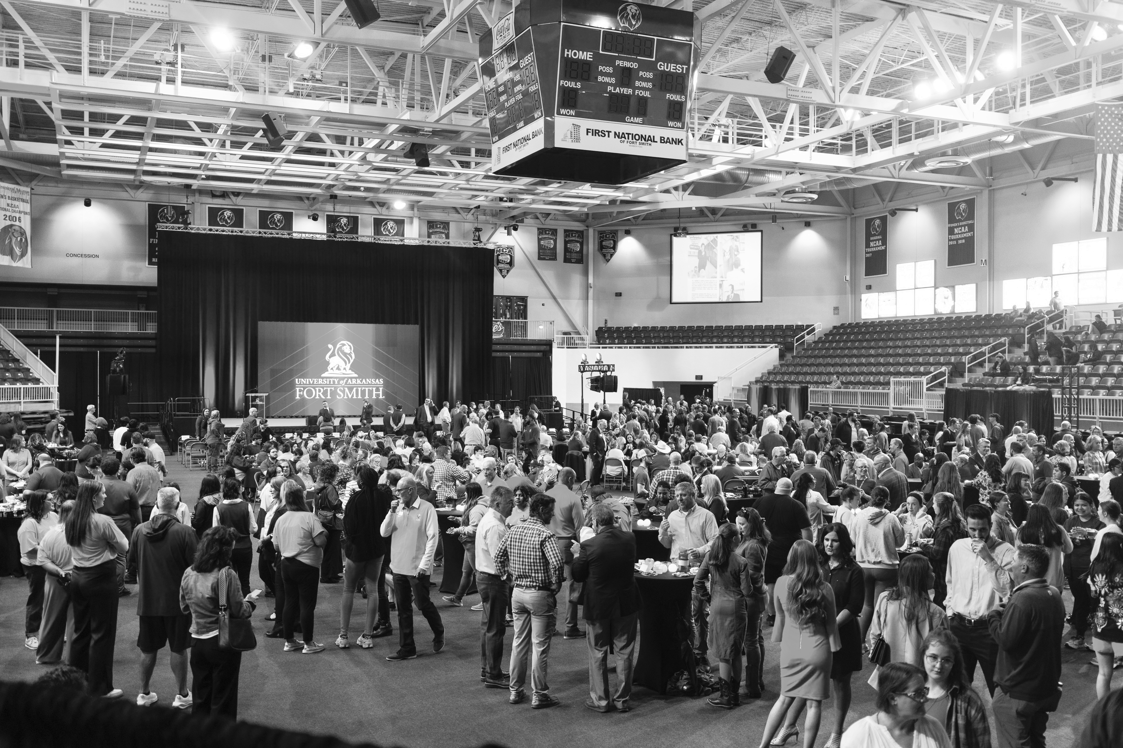
The History of This Campaign
The Launch
1st Meeting with TCR
The Winkler Group
The Early Process

Slide 21

Intrepid Ambition

